Slide 1
How Plants Get Their Energy
The process of energy storage and use in plants:
Sunlight is captured by chlorophyll in the chloroplasts in the mesophyll cells of plant leaves.
This energy is used to supply energy to drive the reactions of photosynthesis.
The plant then uses the carbohydrate molecules produced from photosynthesis to make lipids and proteins.
When the plant requires energy for its metabolism, it breaks down some of these molecules in respiration and makes ATP.
Hydrolysis of ATP to make energy available for use in cells.

Slide 2
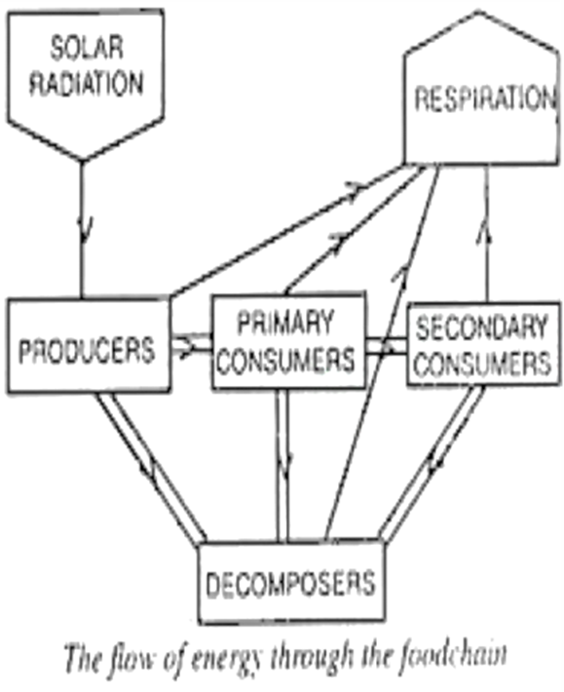
How Animals Get Their Energy
Process of energy use in animals:
Animals feed on plants.
They then take in some energy from the carbohydrates, lipids, and proteins that were in the plants.
When animals require energy for their metabolism, they break down some of these molecules in respiration and make ATP.
The ATP is then made ready for use in cells through hydrolysis.

Slide 3
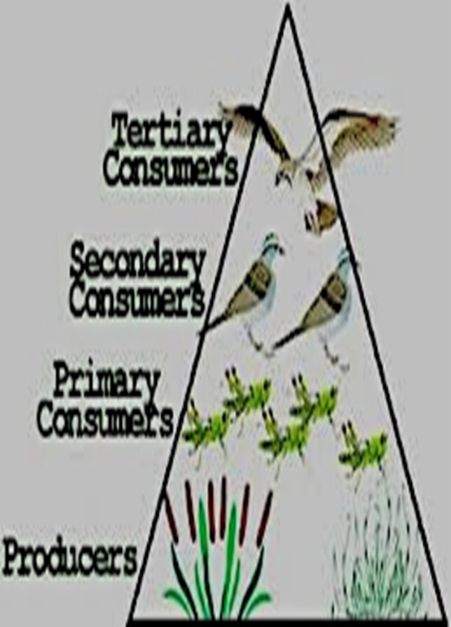
The way energy flows from producers to consumers can be shown by drawing a food chain. Arrows in the food chain indicate the direction in with the energy flows. The animal that eats the autotrophs are the primary consumers, the animal that eats the primary consumer is the secondary consumer and the animal that eats the secondary consumer is the tertiary consumer. These different positions in a food chain are called trophic levels.

Slide 4
Continued…
A food web shows the importance of decomposers, which feed on detritus. Sometimes, the term “decomposer” is used only for bacteria and fungi, which feed saprotrophically, while the larger animals are called detritivores

Slide 5
The Nitrogen Cycle
Nitrogen is an essential element for all living organisms, because of its presence in proteins and nucleic acids. There is a large quantity of nitrogen in the air, but most organisms cannot use this nitrogen because nitrogen gas exists as molecular nitrogen, in which two nitrogen atoms are linked with a triple covalent bond. This form is very unreactive and therefore is not usable.
Before nitrogen can be used by living organisms it must be converted from N2 into some more reactive from, such as ammonia or nitrate.
Nitrogen Fixation
Nitrogen fixation can take place naturally or synthetically

Slide 6
Use of Fixed Nitrogen by Plants
Most nitrogen ends up as part of protein molecules in the plant, especially in seeds and storage tissues
Legumes use it to create amino acids which are distributed by the xylem to synthesis proteins
Some plants rely on supplies of fixed nitrogen in the soil. Their root hairs take up nitrate ions by active transport, which are transformed into amino acids in the roots before being distributed
Other plant species transport nitrate ions in the xylem to the leaves before they are converted

Slide 7
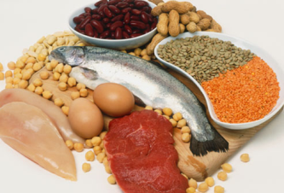
Use of Nitrogen by Animals
Animals including humans can only use nitrogen when it is part of an organic molecule. During digestion, proteins are broken down to amino acids before being absorbed into the blood and distributed to all cells in the body. Excess amino acids are deaminated in the liver, where the nitrogen becomes part of urea molecules. These are excreted in urine.

Slide 8
Return of nitrogen to the soil from living organisms
The proteins released when a plant or animal dies are gradually broken down to amino acids, which are in turn broken down by decomposers that change it into ammonia.
Ammonia in the soil is rapidly converted to nitrite ions and then nitrate ions by a group of bacteria called nitrifying bacteria. The conversion of ammonia to nitrates is called nitrification.
Nitrification only occurs freely in well-aerated soils
Important terms:
Ammonification

Slide 9
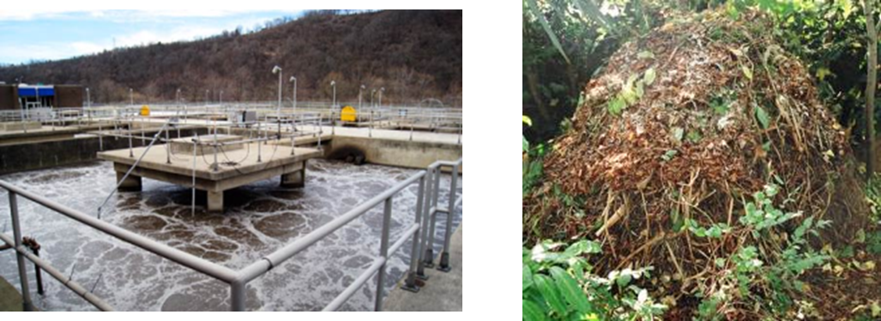
Denitrification
This brings the nitrogen cycle full circle
Denitrifying bacteria provide themselves with energy by reversing nitrogen fixation and converting nitrate to nitrogen gas, which is returned to the air.

